Slide 1
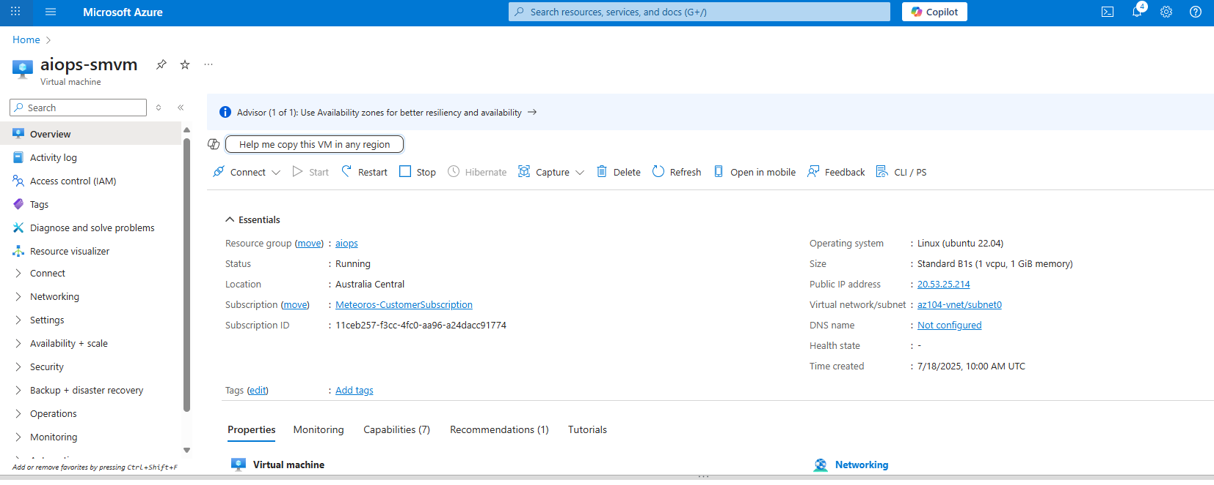
VM Created

Slide 2


Logged in to the VM
ML Jobs

Slide 3
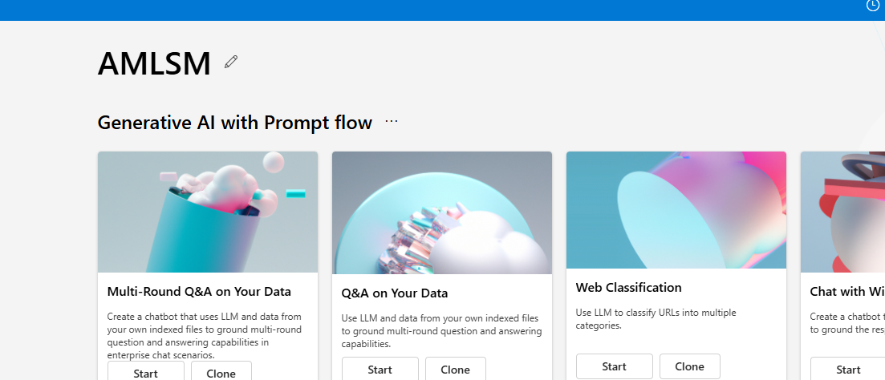
Workspace Created

Slide 4
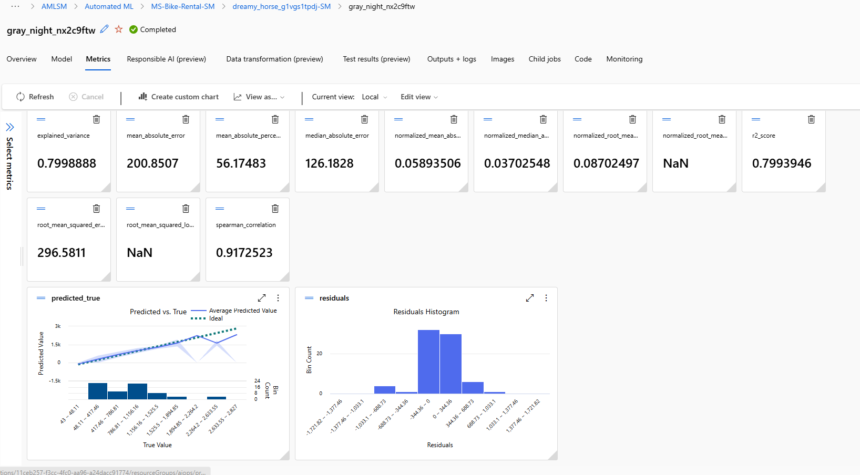

Slide 5
